Slide 1

ASTRA SAFE
IoT-Based Smart Women’s Safety Belt
Concealed
SOS button
Hardware Implementation
ESP32-C3 SuperMini
GPS Module
MPU6050
SOS Button
Illustration: user wearing the safety belt
Prototype connected to a computer over USB
Notes:
Welcome to Astra Safe. This presentation explains the HARDWARE of our safety belt prototype. Key terms: IoT (Internet of Things) means everyday devices with electronics that can sense and exchange data. ESP32-C3 SuperMini is a small microcontroller board, i.e. a tiny computer on one chip. GPS is the Global Positioning System, which tells a receiver its location. The SOS button is a hidden push button for emergency input. In this prototype the board talks to a computer through a USB cable. The illustration is only a concept picture of a person wearing the belt with a concealed button.

Slide 2
Project Overview
Why a hidden SOS button, and what this prototype does
1
Problem
In an emergency, reaching for and unlocking a phone may be difficult or unsafe.
2
Idea
A hidden SOS push button on the belt gives a quick, discreet emergency input.
3
Detection
The ESP32-C3 microcontroller detects when the SOS button is pressed.
4
Motion
An MPU6050 motion sensor (accelerometer and gyroscope) measures movement so the program can detect a fall.
5
Location
A GPS module provides location coordinates (latitude and longitude).
6
Data transfer
The prototype transfers the data to a computer through a USB cable.
IoT-Based Smart Women’s Safety Belt | Hardware Implementation
2
Notes:
Problem: in danger, taking out a phone, unlocking it and opening an app costs precious time. Our idea is a dedicated button that is hidden on the belt. Motion: an MPU6050 sensor measures acceleration and rotation so the program can detect a fall. Microcontroller: a small chip-sized computer that reads inputs and runs a program. GPS gives latitude and longitude, which are the numbers that describe a place on Earth. USB (Universal Serial Bus) is the cable link used here to move data to a computer. Note: this prototype does not send alerts to contacts by itself; it only transfers data to a computer.

Slide 3
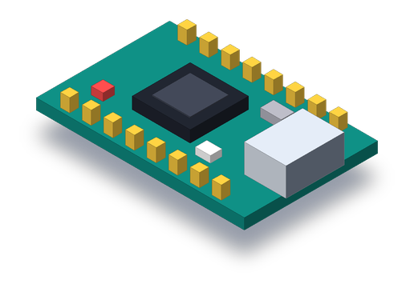
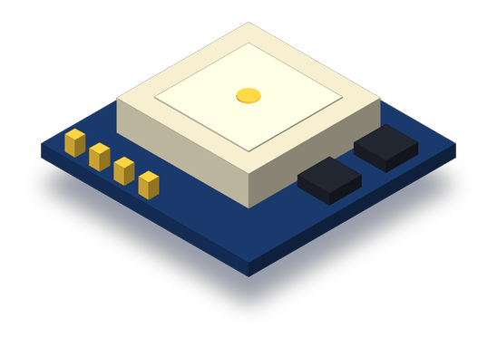
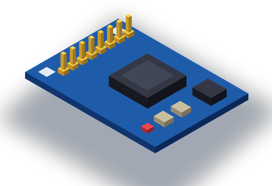

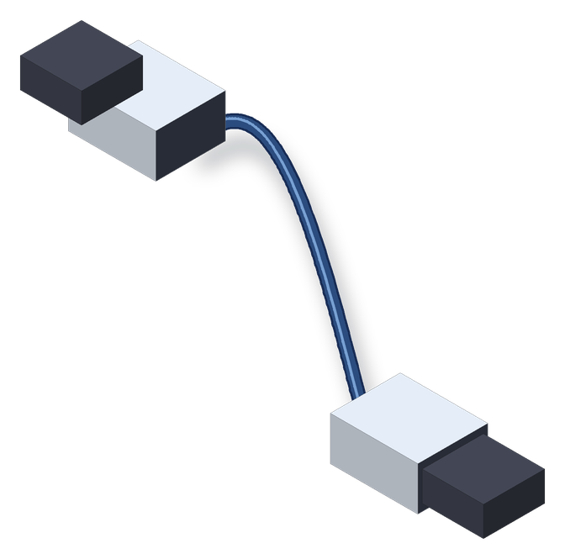
Hardware Components
Five building blocks of the prototype
ESP32-C3 SuperMini
GPS Module
MPU6050 Motion Sensor
Hidden SOS Push Button
USB Cable
Microcontroller. Reads the SOS button and coordinates the programmed operations.
Receives satellite signals and calculates latitude and longitude.
Accelerometer and gyroscope. Measures motion so the program can detect a fall.
Provides the emergency input signal when pressed.
Connects to the computer for data transfer; may also power the board during USB operation.
IoT-Based Smart Women’s Safety Belt | Hardware Implementation
3
Notes:
1) ESP32-C3 SuperMini: the controller. Microcontroller means a small programmable chip that reads inputs and controls outputs. 2) GPS module: a receiver that listens to satellites and computes latitude and longitude. 3) MPU6050: a motion sensor with an accelerometer (measures acceleration) and a gyroscope (measures rotation); the program can use its readings to detect a fall. 4) SOS push button: a simple switch; pressing it completes an electrical connection which the board can sense. 5) USB cable: carries data between board and computer, and may supply power to the development board while connected. Pictures are simplified drawings, not exact product photos.

Slide 4
ESP32-C3 SuperMini
The main controller of the prototype
Microcontroller: a tiny programmable computer on a chip that reads inputs and controls outputs.
Role: main controller; runs the program and coordinates the hardware.
Pins: an input pin reads a signal (e.g. button); an output pin sends one. GPIO = General-Purpose Input/Output.
Connections: SOS button on a GPIO pin; GPS module on UART TX/RX pins; MPU6050 on I2C SDA/SCL pins.
USB: connects the board to the computer for serial data transfer.
GPIO pins (input / output)
USB-C port → computer
ESP32-C3 chip
Simplified illustration – not to scale
IoT-Based Smart Women’s Safety Belt | Hardware Implementation
4
Notes:
A microcontroller is a small computer with processor, memory and pins in one chip. Input pin: the board listens for a signal, for example the button being pressed. Output pin: the board drives a signal out. GPIO stands for General-Purpose Input/Output: pins that can be set as either. UART is a simple two-wire serial link (TX transmit, RX receive) used to talk to the GPS module. The board also has a USB port, which links it to the computer. Exact pin numbers depend on the board wiring and are confirmed during assembly.

Slide 5
GPS Module
Location acquisition – it determines position, it does not send messages
GPS: Global Positioning System – a network of satellites orbiting Earth.
How it works: the module receives satellite signals and calculates its position from them.
Latitude: position north or south of the equator.
Longitude: position east or west of the prime meridian.
Limit: GPS only finds location; it does not message anyone. Performance depends on satellite visibility.
Satellites
Sample coordinates (illustrative only)
Latitude: 19.0000° N
Longitude: 73.0000° E
IoT-Based Smart Women’s Safety Belt | Hardware Implementation
5
Notes:
GPS stands for Global Positioning System. Satellites continuously broadcast signals; the GPS module measures them and calculates where it is. Latitude tells how far north or south, longitude how far east or west, both in degrees. The sample numbers on the slide are ILLUSTRATIVE only, not real readings from our module. Important: GPS only finds location. It does not send messages to anyone. It may take time to get a first fix, and it depends on a clear view of the sky, so we do not claim exact accuracy or guaranteed indoor operation.

Slide 6
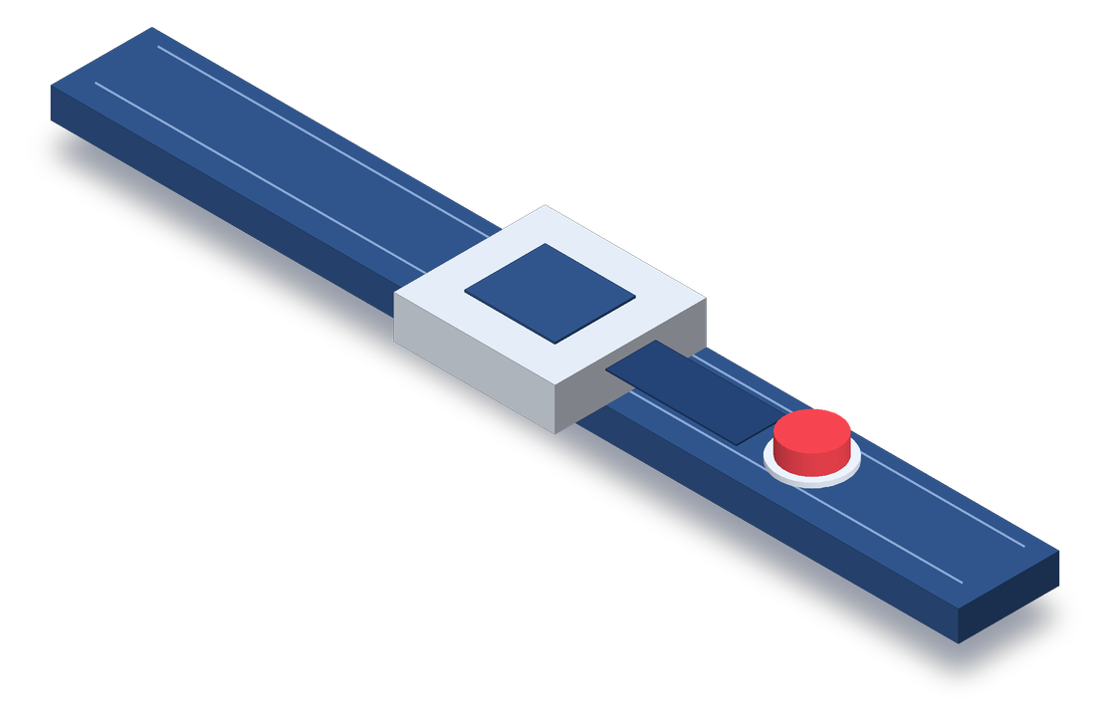
SOS Button and Its Working
A digital input read by the ESP32-C3
Not pressed
Pressed
Hidden placement on the belt
Circuit open
GPIO connected to GND
Concealed SOS button
GPIO reads HIGH (1)
GPIO reads LOW (0)
if (button input == LOW)
→ SOS detected (programmed logic)
The button only provides an input signal. The ESP32-C3 program decides what happens next; the button does not send an alert on its own.
3D illustration – button concealed so it can be pressed discreetly.
IoT-Based Smart Women’s Safety Belt | Hardware Implementation
6
Notes:
A digital input has only two states: HIGH (1) or LOW (0). We use the board's internal pull-up resistor, which gently holds the pin HIGH when the button is not pressed. When the button is pressed, it connects the pin to ground (GND, 0 volts) so the pin reads LOW. The ESP32-C3 program checks the pin and treats LOW as an SOS press. Pull-up resistor: a resistor that pulls a pin to the supply voltage so it never floats. The button itself does not send any alert; it only gives the signal.

Slide 7
Hardware Connections
Wiring diagram – pin numbers, GPS model and MPU6050 I2C pins are placeholders until confirmed
ESP32-C3
SuperMini
Power
Pull-up on GPIO; pressed = LOW
Ground
SOS push
button
GPIO_BTN (pin TBC)
Signal
USB
GND
Computer
serial monitor /
application
GPS module (TBC)
VCC
3V3
GND
GND
USB cable
(data + power)
TX
RX (GPIO_RX TBC)
RX
TX (GPIO_TX TBC)
MPU6050 (I2C sensor)
3V3
VCC
GPS TX → ESP32 RX
ESP32 TX → GPS RX
GND
GND
SDA
SDA
SCL
SCL
TBC = to be confirmed. GPS VCC per module datasheet. ESP32-C3 GPIO is 3.3 V: GPS UART must be 3.3 V logic (else use a level shifter). MPU6050 connects over I2C (SDA/SCL) at 3.3 V; SDA/SCL pins TBC.
IoT-Based Smart Women’s Safety Belt | Hardware Implementation
7
Notes:
This is the wiring plan. The exact GPIO numbers and the GPS model are placeholders (TBC = to be confirmed) and will be fixed from the actual board and module. Button: one side to a GPIO pin, the other side to GND; the pin uses the internal pull-up so pressing gives LOW. GPS: power and ground, then UART. UART is a two-wire serial link and the lines cross: the GPS module's TX (transmit) goes to the ESP32's RX (receive), and the ESP32's TX goes to the GPS module's RX. Voltage levels: the ESP32-C3 works at 3.3 volts, so the GPS signals must also be 3.3 V logic; if a module uses 5 V logic a level shifter is needed. The MPU6050 is a motion sensor (accelerometer plus gyroscope) used for fall detection. It talks to the ESP32-C3 over I2C, a two-wire bus: SDA is the data line and SCL is the clock line. It is powered from 3V3 and GND, and the SDA/SCL GPIO pins are to be confirmed. USB connects the board to the computer.

Slide 8
Hardware Working Flow
From button press to data on the computer
1
2
3
4
5
SOS Button Pressed
ESP32-C3 Detects Input
ESP32-C3 Reads GPS Data
Location Coordinates Processed
Data Transferred to Computer Through USB
GPS acquisition may take time
Depends on satellite reception
Combining is programmed behavior
The first location fix is not instant; it varies with conditions.
Location data is available only when the module receives satellite signals.
Joining SOS and GPS data is done by the program, not an automatic hardware property.
IoT-Based Smart Women’s Safety Belt | Hardware Implementation
8
Notes:
Read left to right. 1) The user presses the hidden button. 2) The ESP32-C3 detects it through its input pin. 3) It reads GPS data from the module over UART. 4) The program processes the coordinates, meaning it picks out latitude and longitude from the GPS text. 5) The result is transferred to the computer through USB. Notes: a GPS fix (first position) can take time, especially at start-up, and needs satellite reception. Combining button and GPS data into one result is something our program does; hardware alone does not do it.

Slide 9

USB Communication
The current data-transfer method in this prototype
USB: Universal Serial Bus – a standard cable link for data (and power) between devices.
Serial data: information sent as a stream of characters, one after another.
Reception: the computer can read the ESP32-C3 data with a suitable serial monitor or application.
Current method: USB is the only data-transfer path in this prototype.
Scope: automatic delivery to a web backend is not claimed; it would need software to be built (future scope).
Serial data flows over USB
USB cable
ESP32-C3 SuperMini
IoT-Based Smart Women’s Safety Belt | Hardware Implementation
9
Notes:
USB means Universal Serial Bus. It is the cable you use for a phone or keyboard. Here it carries serial data, which is simply text or numbers sent one after another, from the ESP32-C3 to the laptop. On the laptop a serial monitor (a program that shows incoming serial text) can display it. USB is the only data-transfer method in our prototype today. We do not claim that a web backend receives this data automatically; that needs extra software and is future scope.

Slide 10
Benefits, Limitations and Future Scope
Benefits
Limitations
Future Scope (not implemented)
Quick emergency input using a dedicated SOS button
GPS-based location acquisition
Motion sensing for fall detection (MPU6050)
USB-based data transfer for prototype testing
Compact microcontroller-based design
Computer connection is required for the described USB data-transfer workflow
GPS performance depends on satellite visibility
USB transfer alone does not guarantee remote notification
Actual performance depends on hardware connections and software implementation
Integrate a suitable independent power source
Add an appropriate communication method for remote emergency notifications
Develop a secure dashboard and trusted-contact notification system
Improve wearable enclosure and concealment
IoT-Based Smart Women’s Safety Belt | Hardware Implementation
10
Notes:
Benefits: the dedicated button is fast, GPS gives location, USB is simple for testing, and the microcontroller design is compact. Limitations: it needs a computer on USB; GPS needs satellite visibility; and USB alone cannot notify anyone remotely. Future scope means ideas NOT yet built: an independent power source, a communication method for remote notification, a secure dashboard with trusted-contact notification, and a better enclosure. None of the future items are claimed as implemented.

Slide 11
Conclusion
The hardware foundation of the safety belt prototype
SOS Button
GPS Module
MPU6050 Sensor
ESP32-C3 SuperMini
USB Cable
Emergency input
Location acquisition
Motion sensing
Coordination
Data transfer
The wearer presses the hidden button to give the input signal.
Calculates latitude and longitude from satellite signals.
Measures acceleration and rotation so the program can detect a fall.
Reads the button, reads GPS data and runs the program.
Carries data to a computer for further processing.
Together they form the hardware base of the prototype. Remote notification and trusted-contact alerts remain future scope.
IoT-Based Smart Women’s Safety Belt | Hardware Implementation
11
Notes:
To conclude, keep the four roles separate. The SOS button gives the emergency input. The GPS module acquires location. The MPU6050 senses motion so the program can detect a fall. The ESP32-C3 coordinates, meaning it reads the inputs and runs the program. USB transfers the data to a computer. Together they are the hardware foundation of the prototype. Sending alerts to trusted contacts is future scope and is not claimed as working. Thank you; we are happy to take questions.

